Slide 1
FINGERPRINT SENSOR
OBJECTIVE:
Arduino Security System is made more secure by using Fingerprint Sensor. The sensor used in this project is (Green Light Optical Fingerprint Reader Sensor Module for Arduino). This fingerprint system can be used on multiple fingers / users.
PHYSICAL COMPONENTS / PARTS:
1 x Arduino-UNO
1 x Crystal-LCD (3.3v / 5v)
1 x Solenoid Lock (12 v) (Atop lee 1pcs Mini Door Drawer)
1 x Servo Motor (5 v) (Tower Pro SG90 )
1 x Finger Print Sensor (3.3v / 5 v) (Adapter FTDI FT232)
1 x Breadboard
1 x Transistor (Power Transistor 55V 49A)
MUHAMMAD ABBAS

Slide 2
LOGIC
Finger Image Stored
Finger Begin ()
Finger Scan ()
IF Finger Scan()
INVALID
Access Denied
Else
Door Open
Door Delay()
Servo Turns Angle 0 to 180
Servo Delay()
Servo Turns Angle 180 to 0
Servo Delay()
Door Close
MUHAMMAD ABBAS

Slide 3
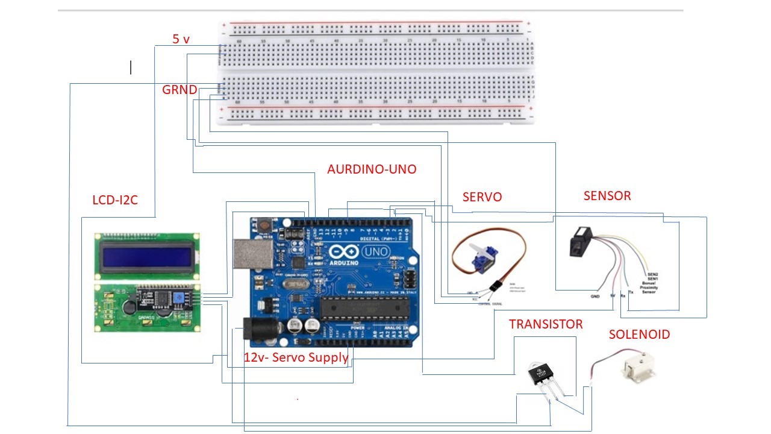
ELECTRICAL DIAGRAM
Electrical Mimic Diagram:
MUHAMMAD ABBAS

Slide 4
CODE:
https://github.com/aabbas210/Arduino_Security_System/blob/master/Fingerprint_Sensor_Code
MUHAMMAD ABBAS

